Slide 1
How to Crack (Hack) a Password
Samarendranath B

Slide 2
What is Password Cracking?
Password cracking is the process of attempting to gain Unauthorized access to restricted systems using common passwords or algorithms that guess passwords.
It’s the art of obtaining the correct password that gives access to a system protected by an authentication method.
The cracking process can involve either comparing stored passwords against word list or use algorithms to generate passwords that match

Slide 3
What is password strength?
Password strength is the measure of a password’s efficiency to resist password cracking attacks. The strength of a password is determined by;
Length: the number of characters the password contains.
Complexity: does it use a combination of letters, numbers, and symbol?
Unpredictability: is it something that can be guessed easily by an attacker?

Slide 4
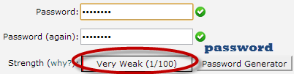


Example
We will use three passwords namely
1. password
2. password1
3. #password1$
The higher the strength number, better the password.

Slide 5
Example
Suppose we have to store our above passwords using md5 encryption. We will use an online md5 hash generator to convert our passwords into md5 hashes.
Password | MD5 Hash | Cpanel Strength Indicator
password | 5f4dcc3b5aa765d61d8327deb882cf99 | 1
password1 | 7c6a180b36896a0a8c02787eeafb0e4c | 28
#password1$ | 29e08fb7103c327d68327f23d8d9256c | 60

Slide 6


Example
We will now use http://www.md5this.com/ to crack the above hashes. The images below show the password-cracking results for the above passwords.

Slide 7
Password cracking techniques
Dictionary attack– This method involves using a wordlist to compare against user passwords.
Brute force attack– This method is similar to the dictionary attack. Brute force attacks use algorithms that combine alpha-numeric characters and symbols to develop passwords for the attack. For example, a password of the value “password” can also be tried as p@$$word using the brute force attack.

Slide 8
Password cracking techniques
Rainbow table attack– This method uses pre-computed hashes. Let’s assume that we have a database that stores passwords as md5 hashes. We can create another database that has md5 hashes of commonly used passwords. We can then compare our password hash against the stored hashes in the database. If a match is found, then we have the password.
Guess– As the name suggests, this method involves guessing. Passwords such as qwerty, password, admin, etc. are commonly used or set as default passwords. If they have not been changed or the user is careless when selecting passwords, they can be easily compromised.

Slide 9
Password cracking techniques
Spidering– Most organizations use passwords that contain company information. This information can be found on company websites and social media such as Facebook, Twitter, etc.
Spidering gathers information from these sources to come up with word lists. The word list is then used to perform dictionary and brute force attacks.

Slide 10
Spidering sample dictionary attack wordlist
1976 <founder birth year>
smith jones <founder name>
acme <company name/initials>
built|to|last <words in company vision/mission>
golfing|chess|soccer <founders hobbies

Slide 11
Password cracker Tools
These are software programs that are used to crack user passwords.
John the Ripper
John the Ripper uses the command prompt to crack passwords. This makes it suitable for advanced users who are comfortable working with commands. It uses a wordlist to crack passwords. The program is free, but the word list has to be bought. It has free alternative word lists that you can use. Visit the product website https://www.openwall.com/john/ for more information and how to use it.

Slide 12
Password cracker Tools
Ophcrack
Ophcrack is a cross-platform Windows password cracker that uses rainbow tables to crack passwords. It runs on Windows, Linux and Mac OS. It also has a module for brute force attacks among other features. Visit the product website https://ophcrack.sourceforge.io/ for more information and how to use it.
mSpy
With mspy, a keylogger application, you can discreetly observe all the words someone types without needing to be physically present. This tool allows you to keep track of every keystroke, tap on a device, and monitor popular chat apps such as WhatsApp, Instagram, Tinder, Snapchat, and Viber. Effortlessly view all text messages and instant messages, and use the built-in GPS tracker to locate a device’s position.

Slide 13
Password cracker Tools
Cain & Abel
Cain & Abel runs on windows. It is used to recover passwords for user accounts, recovery of Microsoft Access passwords; networking sniffing, etc. Unlike John the Ripper, Cain & Abel uses a graphic user interface. It is very common among newbies and script kiddies because of its simplicity of use. Visit the product website https://sectools.org/tool/cain/ for more information and how to use it.

Slide 14
Password Cracking Counter Measures
An organization can use the following methods to reduce the chances of the passwords being cracked.
Avoid short and easily predictable passwords
Avoid using passwords with predictable patterns, such as 11552266.
Passwords stored in the database must always be encrypted. For md5 encryptions, it’s better to salt the password hashes before storing them. Salting involves adding some words to the provided password before creating the hash.
Most registration systems have password strength indicators. Organizations must adopt policies that favor high password-strength numbers.

Slide 15
Hack Now!!!
Crack a Windows account with a simple password. Windows uses NTLM hashes to encrypt passwords. We will use the NTLM cracker tool in Cain and Abel to do that.
Cain and Abel cracker can be used to crack passwords using;
Dictionary attack
Brute force
Cryptanalysis
We will use the dictionary attack in this example. You will need to download the dictionary attack wordlist here 10k-Most-Common.zip

Slide 16
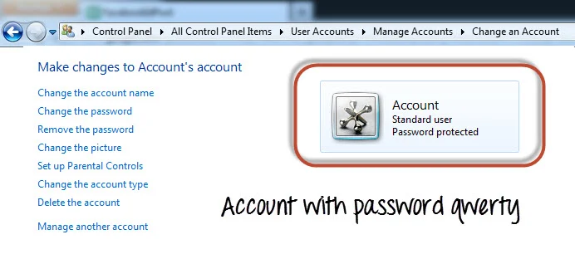
Hack Now!!!
We have created an account called Accounts with the password qwerty on Windows 7.

Slide 17
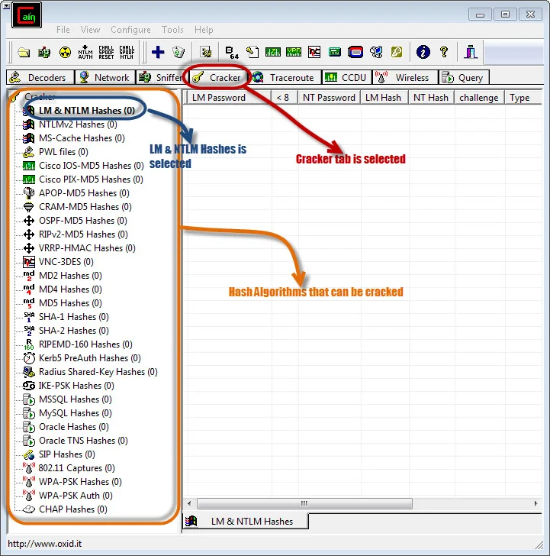
Step 1) Open Cain and Abel.

Slide 18
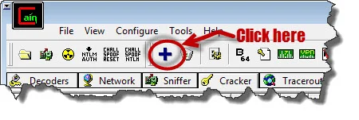
Step 2) Find Add button.

Slide 19
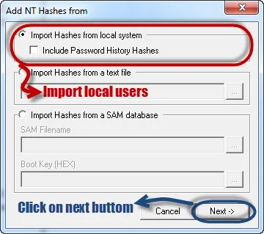
Step 3) Check dialog box.

Slide 20
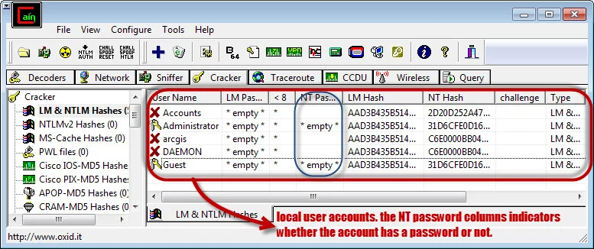
Step 4) The local user accounts will be displayed as follows.

Slide 21
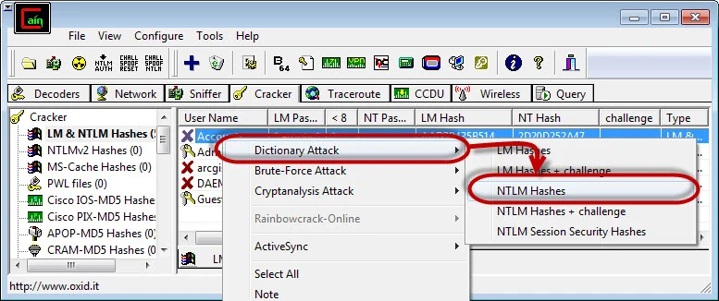
Step 5) Right click on the account you want to crack.

Slide 22
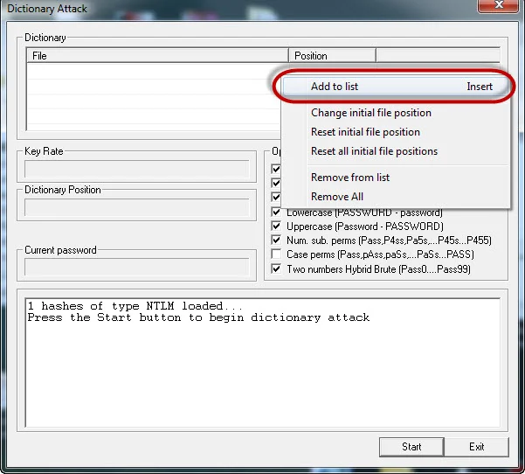
Step 6) Check below screen.

Slide 23
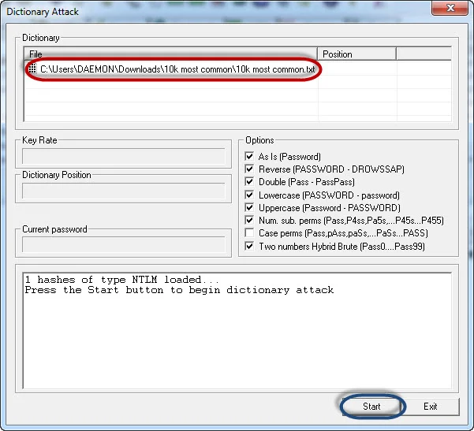
Step 7) Browse File.

Slide 24
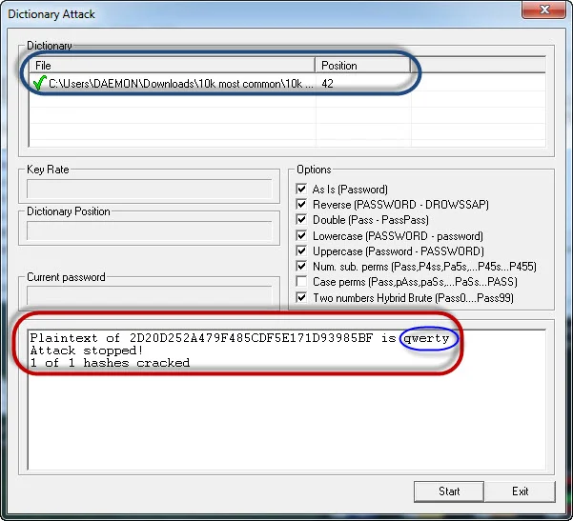
Step 8) Check results.

Slide 25
Summary
Password cracking is the art of recovering stored or transmitted passwords.
Password strength is determined by the length, complexity, and unpredictability of a password value.
Common password techniques include dictionary attacks, brute force, rainbow tables, Spidering, and cracking.
Password cracking tools simplify the process of cracking passwords.

